Slide 1

6th Grade Accelerated Math
Unit 13, Lesson 7 Adding and Subtracting Linear Expressions with Integer Coefficients Volume 2, pg. 294

Slide 2


Benchmark
MA.7.AR.1.1
Apply properties of operations to add and subtract linear expressions with rational coefficients.
volume 2, pg. 294

Slide 3
Integrated Mathematical Thinking and Reasoning Standards
MA.K12.MTR.2.1 Demonstrate understanding by representing problems in multiple ways.
MA.K12.MTR.5.1 Use patterns and structure to help understand and connect mathematical concepts.
volume 2, pg. 294

Slide 4

Learning Target
I can use algebra tiles to add and subtract linear expressions.
volume 2, pg. 294

Slide 5

Warm-Up
volume 2, pg. 295

Slide 6
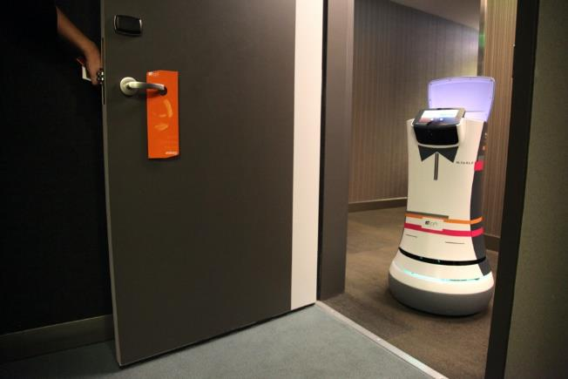
13.7.1 Warm-Up: Career in Robotics
Tessa Lau is the Chief Robot Whisperer for a robotics company. The company creates robot helpers for the service industry. Some of their robots perform tasks like delivering items to guests at a hotel. Tessa has studied applied physics, computer science, artificial intelligence, and human-computer interaction. She loves hands-on experiments, building things, and the speed of creating with computers.
volume 2, pg. 295

Slide 7
Through programming and engineering, one of her primary jobs is to look at a robot in context and make sure the robots behave well in human environments.
Have you ever considered a career as an engineer?
How do you think a robot could be helpful to you in your everyday life?
Tessa’s advice is “Don’t listen to someone who tells you that you can’t do something.” Describe a time someone told you that you were not able to do something.
volume 2, pg. 295

Slide 8

Refresher
volume 2, pg. 295

Slide 9






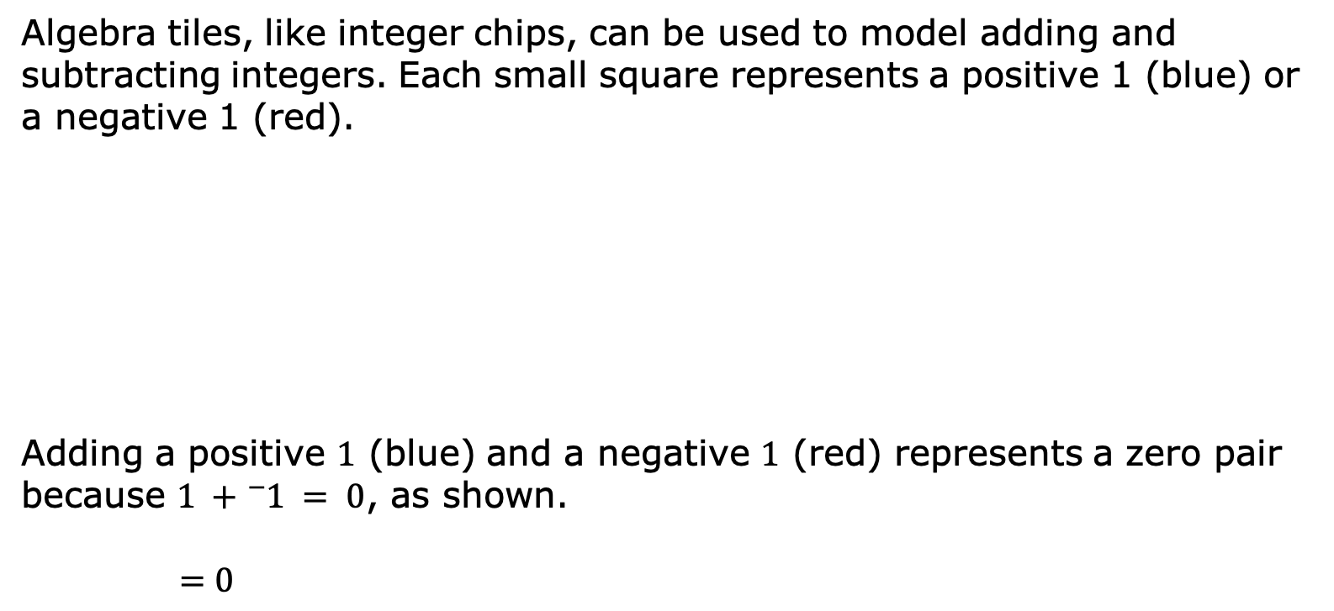
13.7.2 Refresher: Adding and Subtracting Integers with Algebra Tiles
Algebra tiles, like integer chips, can be used to model adding and subtracting integers. Each small square represents a positive 1 (blue) or a negative 1 (red).
Adding a positive $1$ (blue) and a negative $1$ (red) represents a zero pair because $1 +{}_{ }^{−}1 = 0$, as shown.
$$=0$$
Integer Chips | Algebra Tiles
volume 2, pg. 295

Slide 10
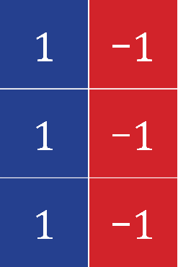
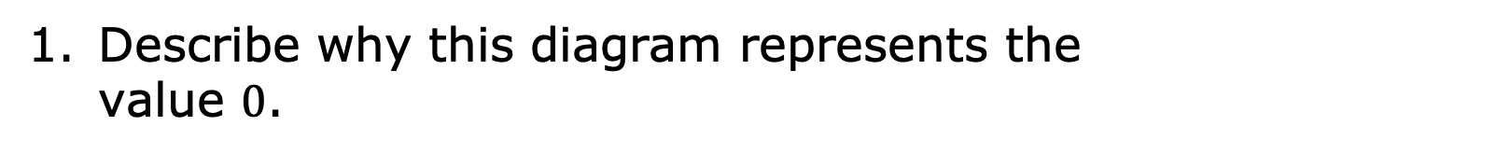
Describe why this diagram represents the value $0$.
A zero pair is a pair of numbers whose sum is zero.
volume 2, pg. 295

Slide 11
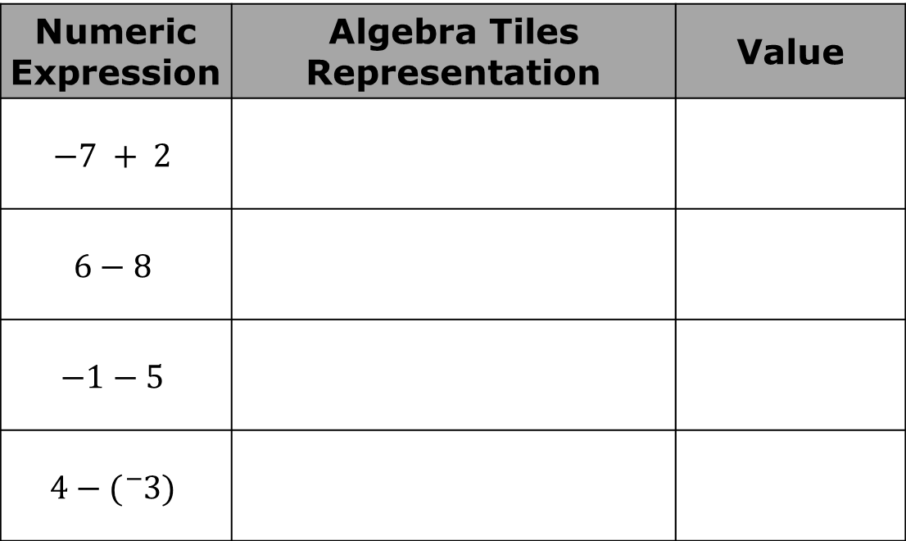
Complete the following problems.
Complete the table.
Numeric Expression | Algebra Tiles Representation | Value
$$−7 + 2$$
$$6−8$$
$$−1−5$$
$$4−({}_{}^{−}{3)}$$
volume 2, pg. 296

Slide 12
For some of the representations with algebra tiles, zero pairs had to be added to the representation. Put an asterisk (*) next to the expressions where this was the case.
Explain why zero pairs had to be added to the representation in these cases.
volume 2, pg. 296

Slide 13

Guided Instruction
volume 2, pg. 296

Slide 14
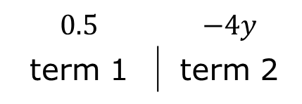
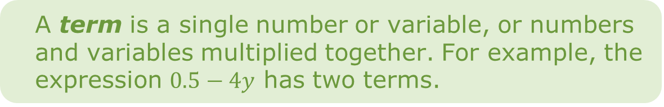
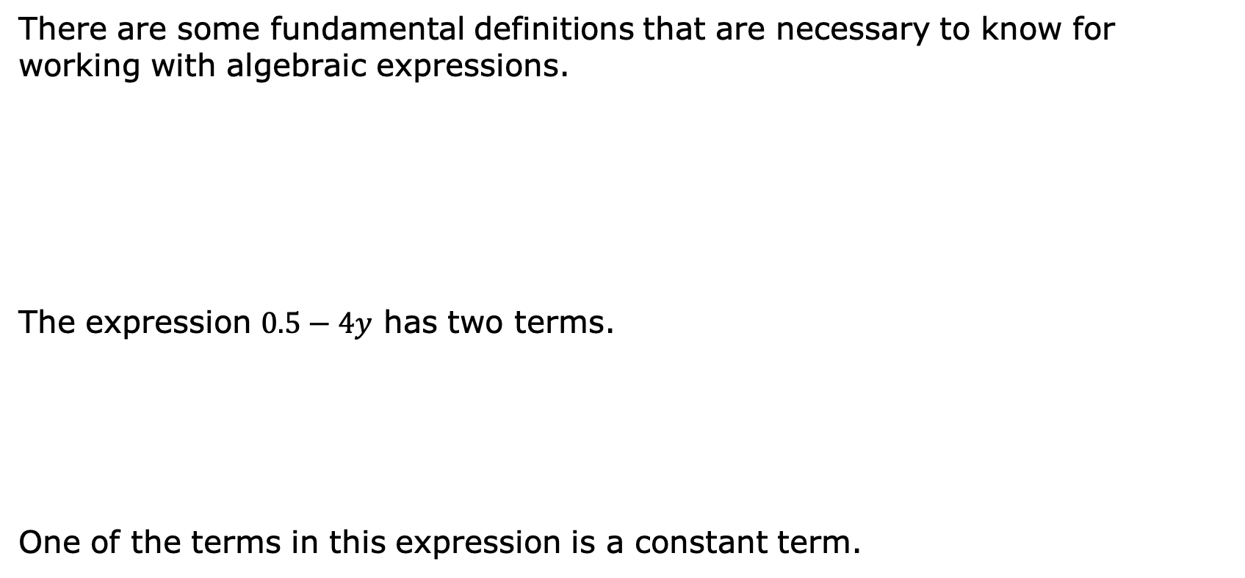
13.7.3 Guided Instruction: Algebra Vocabulary
There are some fundamental definitions that are necessary to know for working with algebraic expressions.
The expression $0.5−4y$ has two terms.
One of the terms in this expression is a constant term.
A term is a single number or variable, or numbers and variables multiplied together. For example, the expression $0.5−4y$ has two terms.
$$0.5$$ | $$−4y$$
term 1 | term 2
volume 2, pg. 296

Slide 15

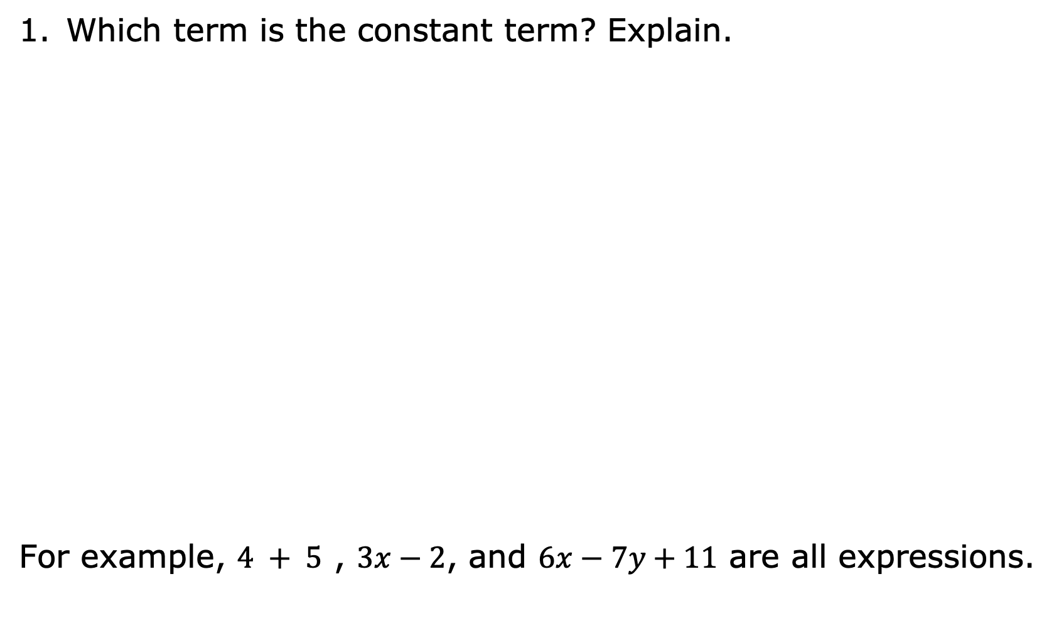
Which term is the constant term? Explain.
For example, $4 + 5$ , $3x−2$, and $6x−7y+11$ are all expressions.
An expression is a mathematical statement containing numerals, operators, grouping symbols, and symbols or variables for unknown values. An expression does not contain an equal sign or inequality symbol.
volume 2, pg. 296

Slide 16
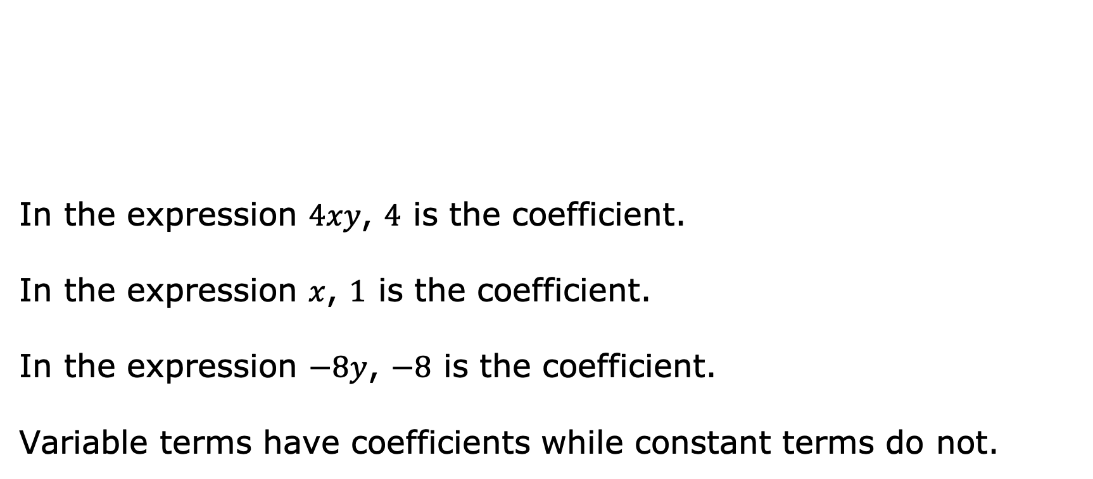
In the expression $4xy$, $4$ is the coefficient.
In the expression $x$, $1$ is the coefficient.
In the expression $−8y$, $−8$ is the coefficient.
Variable terms have coefficients while constant terms do not.
A coefficient is the number or constant that multiplies a variable in an algebraic expression. If no number is specified, the coefficient is 1.
volume 2, pg. 297

Slide 17

Exploration
volume 2, pg. 297

Slide 18








13.7.4 Exploration: What are Like Terms?
Here is a collection of algebra tiles.
volume 2, pg. 297

Slide 19
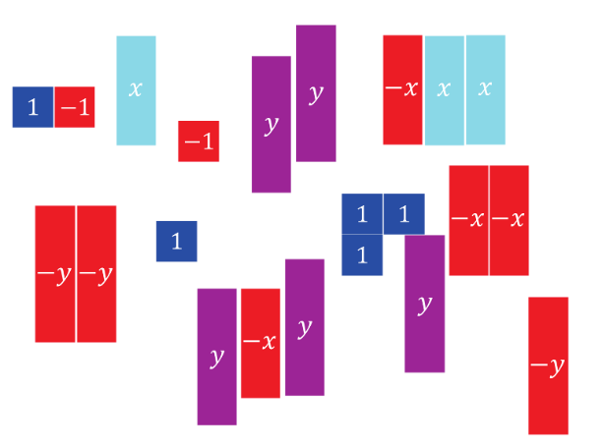
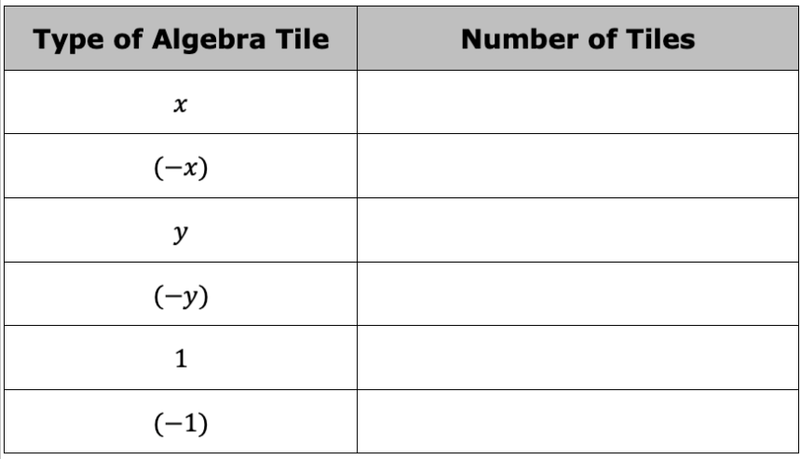
Complete the table below.
volume 2, pg. 297

Slide 20

Use the definitions of coefficient and term to complete the expression by writing the coefficient or constant term that matches the number of tiles of each type.
_____ x + ($−$ _____ x ) + _____ y + ($−$ _____ y ) + _____ + ($−$ _____ )
Draw the number of algebra tiles of each type under the term in the expression.
Circle the zero pairs in your drawing.
volume 2, pg. 298

Slide 21
Complete the expression below after eliminating the zero pairs.
_____ x + _____ y + _____
Like terms are terms with the exact same variable(s) raised to the same exponent.
A constant is a fixed numerical value with no variables. All constants are like terms.
volume 2, pg. 298

Slide 22
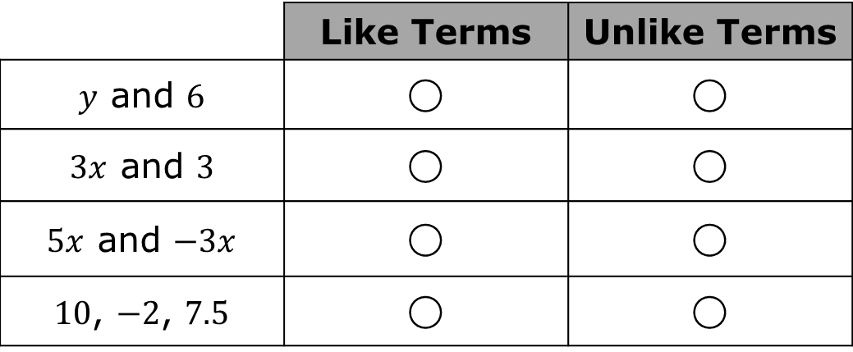
Answer the following questions about like terms.
Classify the following terms.
How did you determine whether the terms were like or unlike?
Compare answers with your partner.
 | Like Terms | Unlike Terms
$y$ and $6$ | ◯ | ◯
$3x$ and $3$ | ◯ | ◯
$5x$ and $−3x$ | ◯ | ◯
$10$, $−2$, $7.5$ | ◯ | ◯
volume 2, pg. 298

Slide 23
Guided Instruction
volume 2, pg. 299

Slide 24
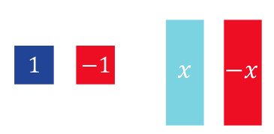
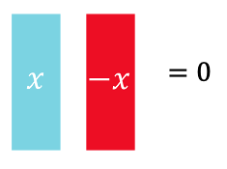
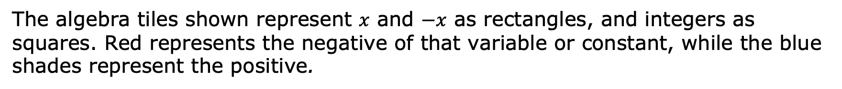
13.7.5 Guided Instruction: Adding and Subtracting Expressions with Algebra Tiles
The algebra tiles shown represent $x$ and $−x$ as rectangles, and integers as squares. Red represents the negative of that variable or constant, while the blue shades represent the positive.
Variables also form zero pairs, as shown.
volume 2, pg. 299

Slide 25
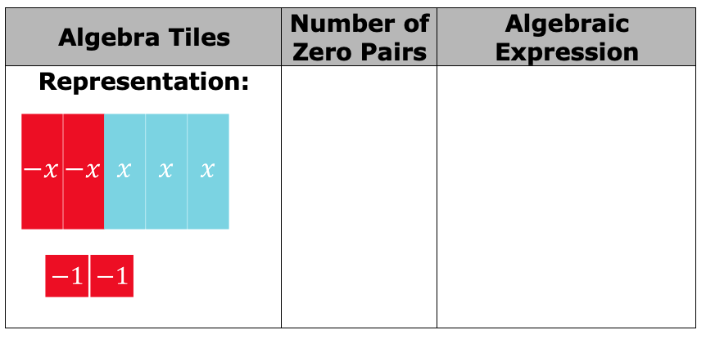
Complete the table by crossing out the zero pairs and recording how many there are. Write the resulting algebraic expression after eliminating the zero pairs.
volume 2, pg. 299

Slide 26
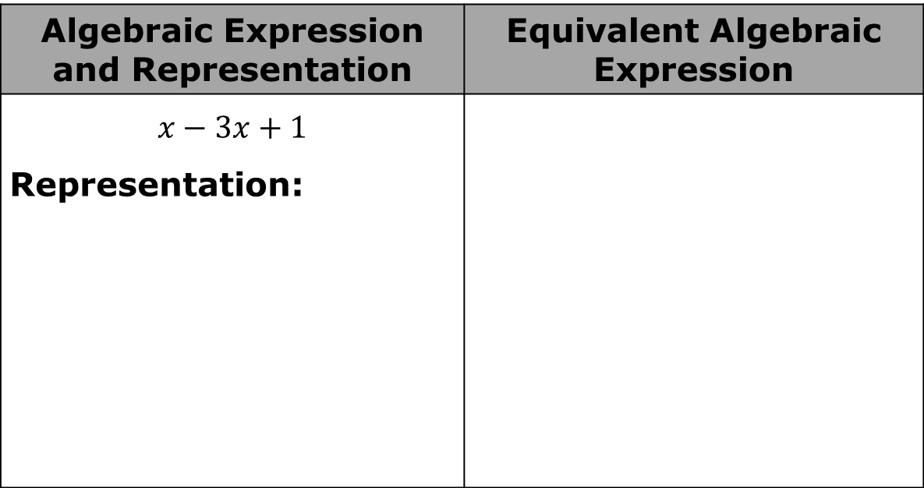
Draw a representation of the following expressions with algebra tiles. Cross out any zero pairs. Then write an equivalent algebraic expression after eliminating any zero pairs.
Algebraic Expression and Representation | Equivalent Algebraic Expression
$$x−3x+1$$ Representation:
volume 2, pg. 299

Slide 27

Algebraic Expression and Representation | Equivalent Algebraic Expression
$$−4+3y−y+2$$ Representation:
volume 2, pg. 299

Slide 28

Guided Practice
volume 2, pg. 300

Slide 29

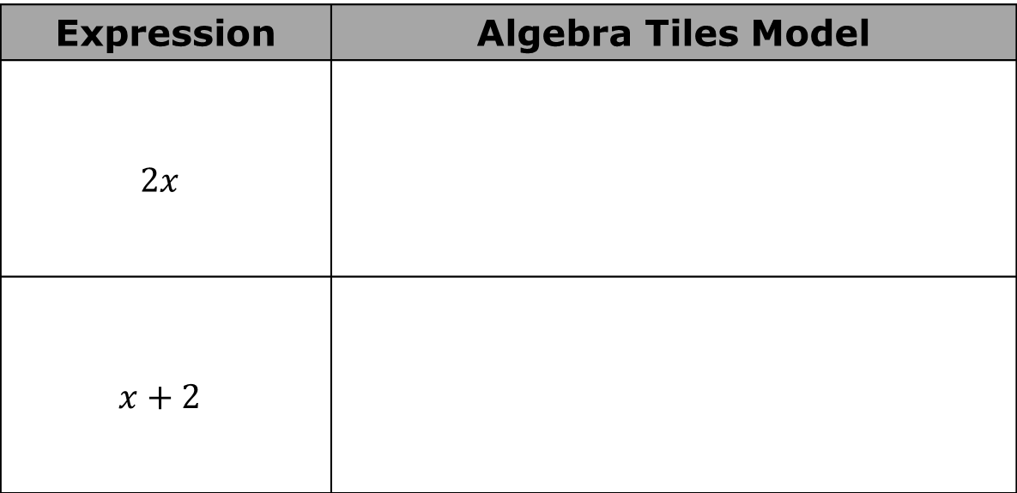
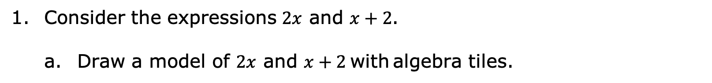
13.7.6 Guided Practice: Adding and Subtracting Expressions with Algebra Tiles
Consider the expressions $2x$ and $x+2$.
Draw a model of $2x$ and $x+2$ with algebra tiles.
Expression | Algebra Tiles Model
$$2x$$
$$x+2$$
volume 2, pg. 300

Slide 30
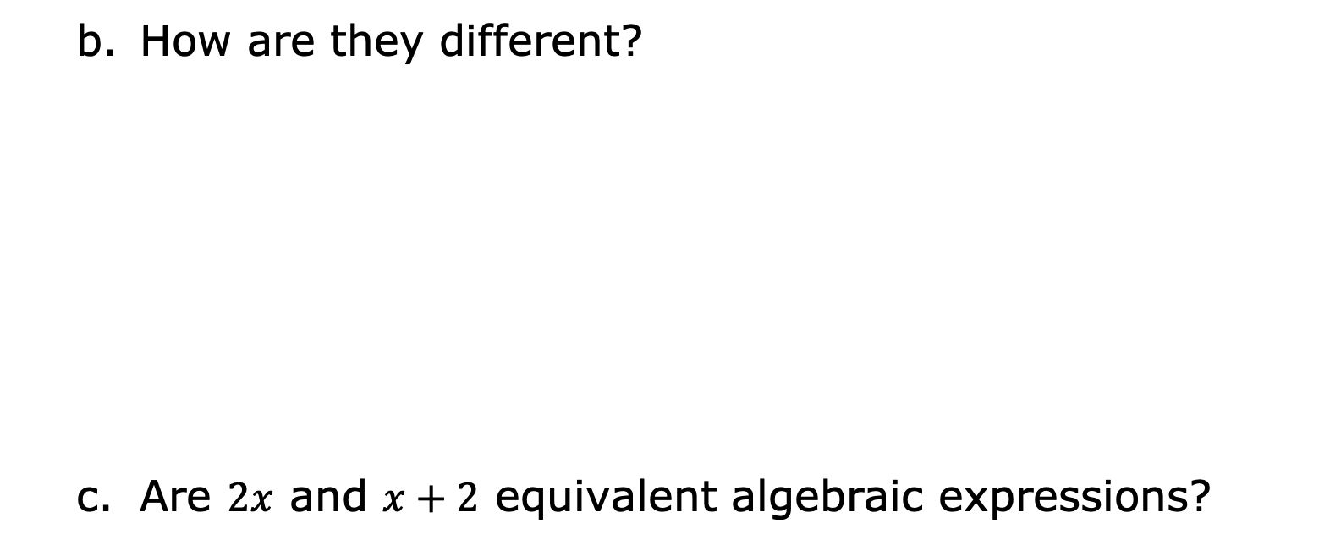
How are they different?
Are $2x$ and $x+2$ equivalent algebraic expressions?
volume 2, pg. 300

Slide 31

Your Turn
volume 2, pg. 300

Slide 32

13.7.7 Your Turn!
Write an equivalent expression by combining like terms.
1. $2x+4x=$ ________________
2. $−y+7+4y−1=$ ________________
3. $x−x+x−x+1=$ ________________
4. $8x−4−4x$ ________________
5. $2x−4x=$ ________________
volume 2, pg. 300

Slide 33

Wrap-Up
volume 2, pg. 301

Slide 34
13.7.8 Wrap-Up: Cool Down
For each key word, check the box in the column that describes your knowledge of the word. Then answer the questions or complete the statements in the last column.
Key Word | I already knew the meaning of this word. | I’ve heard this word before, but I was not sure what it meant. | Questions
Expression | □ | □ | An example of a numeric expression is _____________. An example of an algebraic expression is _____________.
volume 2, pg. 301

Slide 35
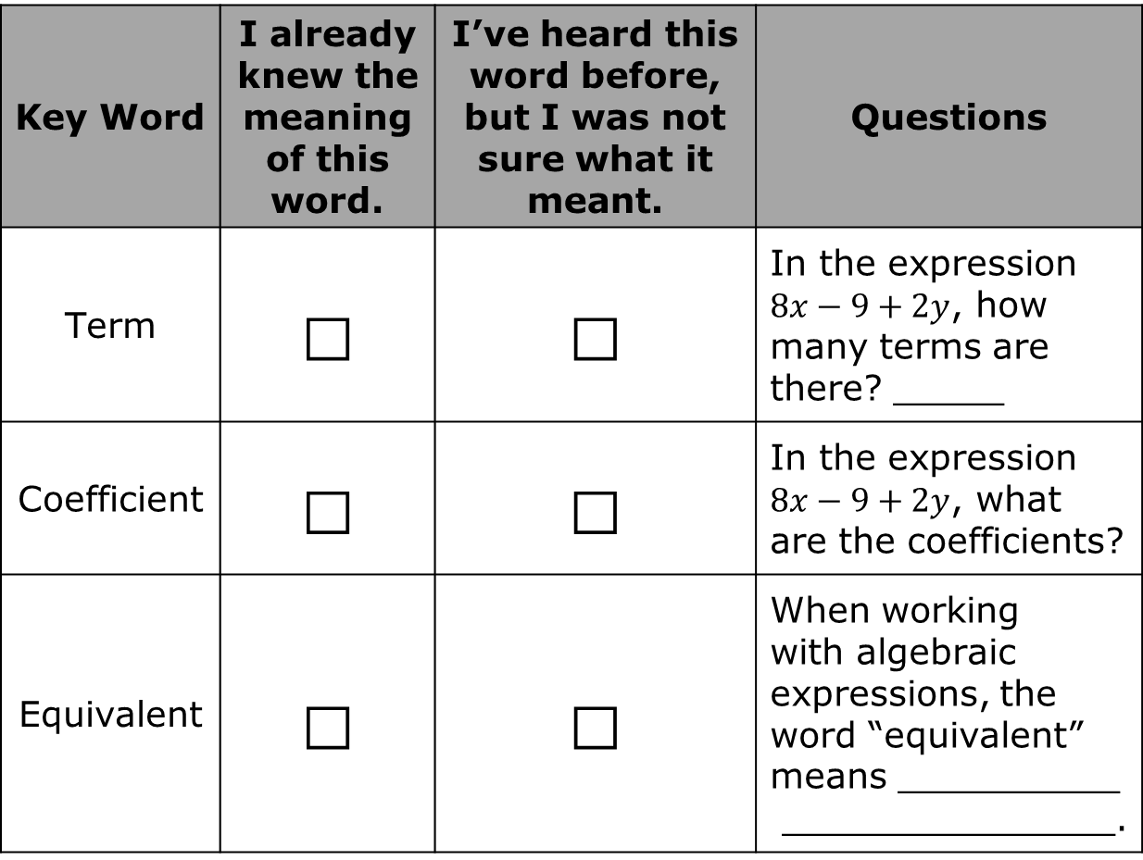
Key Word | I already knew the meaning of this word. | I’ve heard this word before, but I was not sure what it meant. | Questions
Term | □ | □ | In the expression $8x−9+2y$, how many terms are there? _____
Coefficient | □ | □ | In the expression $8x−9+2y$, what are the coefficients?
Equivalent | □ | □ | When working with algebraic expressions, the word “equivalent” means __________ _______________.
volume 2, pg. 301

